Slide 1
PRIESKA PROJECT
A strong foundation for near-term development and long-term growth
Investor Presentation : August 2019

Slide 2
disclaimer
This presentation contains summary information about Orion Minerals Ltd and its subsidiaries (Orion or Company) and their activities and is current as at 2 August 2019. The information in this presentation is a general background and does not purport to be complete or provide all information that an investor should consider when making an investment decision.
No representation or warranty, express or implied, is provided in relation to the accuracy or completeness of the information.
Statements in this presentation are made only as of the date of
this presentation unless otherwise stated and the information in
this presentation remains subject to change without notice.
The Company is not responsible for updating, nor undertakes to update, this presentation. It should be read in conjunction with the Company’s other periodic and continuous disclosure announcements lodged with the Australian Securities Exchange (ASX), which are available at www.asx.com.au and the Johannesburg Stock Exchange (JSE), which are available at www.jse.co.za.
Certain statements contained in this presentation, including
information as to the future financial or operating performance of
Orion and its projects, are forward-looking statements. Such
forward-looking statements:
  are necessarily based upon a number of estimates and assumptions that, while considered reasonable by Orion Minerals Ltd, are inherently subject to significant technical, business, economic, competitive, political and social uncertainties and contingencies;
  involve known and unknown risks and uncertainties that
  could cause actual events or results to differ materially
  from estimated or anticipated events or results reflected
  in such forward-looking statements; and
  may include, among other things, statements regarding targets, estimates and assumptions in respect of metal production and prices, operating costs and results, capital expenditures, mineral reserves and mineral resources and anticipated grades and recovery rates, and are or may be based on assumptions and estimates related to future technical, economic, market, political, social and other conditions.
Orion disclaims any intent or obligation to update publicly any
forward-looking statements whether as a result of new information, future events or results or otherwise.
The words ‘believe’, ‘expect’, ‘anticipate’, ‘indicate’, ‘contemplate’, ‘target’, ‘plan’, ‘intends’, ‘continue’, ‘budget’, ‘estimate’, ‘may’, ‘will’, ‘schedule’ and similar expressions identify forward looking statements.
All forward-looking statements made in this presentation are qualified by the foregoing cautionary statements. Investors are cautioned that forward-looking statements are not guarantees of future performance and accordingly investors are cautioned not to put undue reliance on forward-looking statements due to the inherent uncertainty therein.
All information in respect of Exploration Results and other technical information should be read in conjunction with the relevant ASX announcements released by the Company.
Orion is not aware of any new information or data that materially
affects the information for the Mineral Resource and confirms that
all material assumptions and technical parameters underpinning the estimates in the relevant Orion ASX releases (as referenced in the presentation) continue to apply and have not materially changed.
Orion confirms that the form and context in which the Competent Person’s findings are presented have not materially changed.
To the maximum extent permitted by law, Orion and any of its related bodies corporate and affiliates and their officers, employees, agents, associates and advisers:
  disclaim any obligations or undertaking to release any updates or revisions to the information to reflect any change in expectations or assumptions;
  do not make any representation or warranty, express or implied, as to the accuracy, reliability or completeness of the information in this presentation, or likelihood of
  fulfilment of any forward looking statement or any event or results expressed or implied in any forward-looking statement; and
  disclaim all responsibility and liability for these forward
  looking statements (including, without limitation, liability
  for negligence).
Nothing contained in this presentation constitutes investment, legal, tax or other advice. The information does not take into account the investment objectives, financial situation or particular needs of any recipient. Before making an investment decision, each recipient of this presentation should make its own assessment and take independent professional advice in relation to the information and any action taken on the basis of this presentation.

Slide 3
Copper supply chain

Slide 4
Large copper mines have a very long lead time

Slide 5
Add a major new demand driver

Slide 6
Copper hungry renewable energy

Slide 7
Copper price outlook

Slide 8
Zinc demand – consistent consumption growth

Slide 9
Zinc concentrate market

Slide 10
Zinc metal supply – no stocks to absorb demand
Zinc metal stocks at record lows – strong fundamentals with price subdued by sentiment

Slide 11
Zinc concentrate supply – new mines take time

Slide 12
Zinc concentrate – questionable new mine supply
Consistent delays in major projects coming online – potential for progressive concentrate market tightness

Slide 13
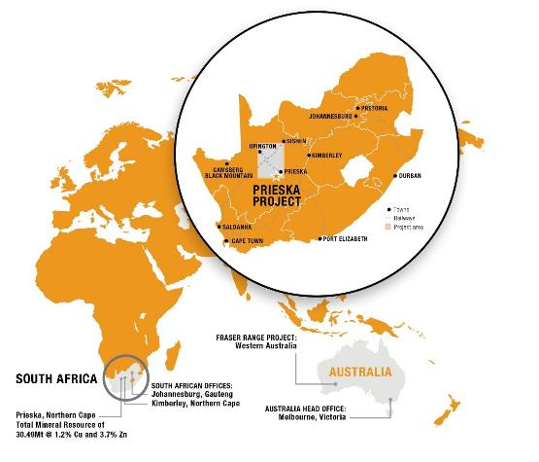
Orion minerals – A compelling investment CASE
THE OREBODY
Globally significant VMS Resource: 30.49Mt @ 1.2% Cu, 3.7% Zn
Mineral Reserve: 13.62Mt @ 1.06% Cu, 3.18% Zn
FOUNDATION PHASE BFS OUTCOMES
Initial 10-year, 2.4Mtpa operation targeting 22ktpa Cu & 70ktpa Zn
Strong operating margins and financials
  Pre-tax free cash flow of A$1.1bn (post-tax A$819m)
  Pre-tax NPV_{8%} of A$574m (post-tax A$408m)
  Peak funding of A$378m
  Payback period of three years from first production
  All-in sustaining margin of 44%
PERMITTING
The granting of the environmental permit is a key milestone for the development of the Prieska Project, clearing the way for the award of the Mining Right.
THE FUTURE
Exceptional exploration and growth pipeline
Refer ASX release 26 June 2019 and ASX release 8 July 2019

Slide 14
PRIESKA: DEVELOPING A NEW MINE
IN THE FOOTPRINT OF AN OLD ONE
Extensive infrastructure already in place:
Primary shafts and underground decline roadways
Sealed access roads to project site
48km via bitumen road to existing rail siding
Four high-voltage regional lines linked to national electricity grid
175MW operational solar power plants in area with additional 675MW approved and 300MW pending authorisation
800km rail link to major bulk commodity and deep-water ports
Bulk water pipeline supplies to site
Good contractor accommodation facilities ~3km from site
Low environmental sensitivity – existing mine footprint

Slide 15
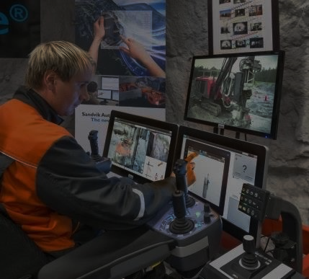
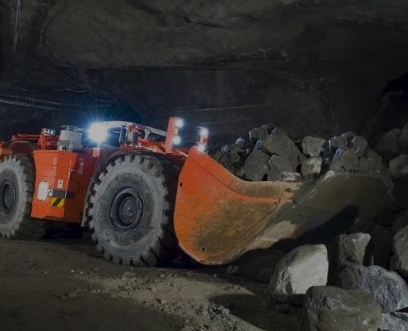
Prieska: mine of the future
Implementing a modern operating philosophy (4IR enabled) can contribute to achieving quantum
changes in key output parameters that are traditionally slow to improve or have regressed in the local mining industry, including:
  Safety and health improvements
  Improved environmental conditions, reduced pollution and contamination
  Improved energy efficiency and lower energy costs
  Productivity improvements
  Operating cost reductions
Benchmark Globally
Implement
Enablers
Be Fast
Followers
Always Make Commercial Sense

Slide 16
https://orionminerals.com.au/news/operational-videos/

Slide 17
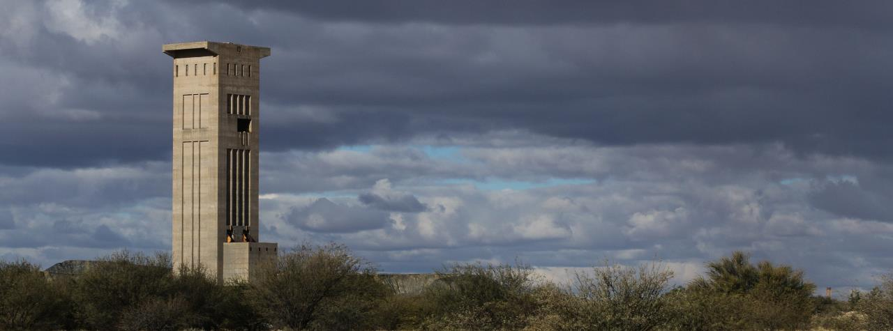
Strong Cashflow
Refer ASX release 26 June 2019

Slide 18
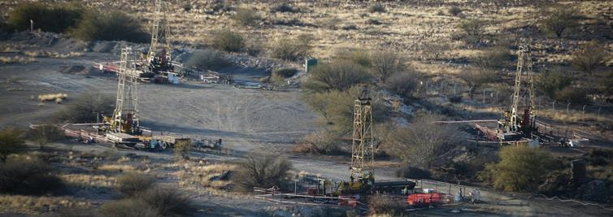
APPENDICES

Slide 19
PRIESKA: REAWAKENING A GLOBAL VMS GIANT
World-class orebody –
recorded as a Top 30 global VMS deposit
Located in Northern Cape Province,
270km south-west of regional capital, Kimberley
Established mining region, yet least populous
region of South Africa
Historically mined by AngloVaal (1971-1991)
Recorded historical production of 1Mt of Zn and
430kt of Cu from 46.8Mt of sulphide ore milled*
Extensive infrastructure in place
Near-mine exploration and further expansion potential
* Source: Mine records

Slide 20


PRIESKA BFS Highlights
FOUNDATION PHASE
LOM Extension phase
Demonstrates compelling investment case to establish financially robust mine with initial 10 year life
  Pre-tax free cash flow of A$1.1bn (post-tax A$819m)
  Pre-tax NPV_{8%} of A$574m (post-tax A$408m)
  Peak funding of A$378m
  Payback period of three years from first production
  All-in sustaining margin of 44%
    Optimisation studies continue
    Investigating by-product production
LOM extensions leveraging off Foundation Phase development and requiring limited or no additional capital works
Tonnage targeted
  Remainder of current Global Resource,
  9.13 Mt at 1.4% Cu and 3.6% Zn
  Evaluating existing pillar extraction (7-8 million tonnes) after voids are paste filled
  High grade strike extensions of resource requiring additional drilling, not yet in JORC resource
Refer ASX release 26 June 2019

Slide 21
BANKABLE FEASIBILITY STUDY DASHBOARD
Price and FX Assumptions | Unit | Value | Financial Performance | Unit | Value
Metal price – Cu | USD/t | 6,834 | NPV pre-tax (post-tax) @ 8.0% discount rate | AUD M | 574 (408)
Metal price – Zn | USD/t | 2,756 | IRR pre-tax (post-tax) | % | 38% (33%)
Exchange rate | ZAR:USD | 14.5 :1 | Payback from first production | years | 2.9
Exchange rate | ZAR:AUD | 10 : 1 | Undiscounted free cash flow pre-tax (post-tax) | AUD M | 1,127 (819)
Exchange rate | AUD:USD | 1.45 : 1 | Peak funding | AUD M | 378
Production Metrics | Unit | Value | Project Cost Metrics | Unit | Value
Life of Mine | Years | 9.7 | Average cash operating unit cost (C1) | AUD/t | 80
Treatment plant capacity | Mtpa | 2.4 | All-in-sustaining cost per unit ROM t | AUD/t | 94
ROM Plant Feed – tonnage | kt | 20,827 | All-in-sustaining cost per unit Cu_Eq t sold | AUD/t Cu | 5,470
ROM Plant Feed – grade - Cu | % | 1.1% | All-in-sustaining cost per unit Zn_Eq t sold | AUD/t Zn | 1,582
ROM Plant Feed – grade - Zn | % | 3.4% | Price received (net of NSR) - Cu | AUD/t Cu | 9,785
Concentrate tonnage - Cu | kt | 790 | Price received (net of NSR) - Zn | AUD/t Zn | 2,830
Concentrate tonnage - Zn | kt | 1,180 | All-in-sustaining margin | % | 44%
Concentrate grade – Cu U/G (O-Pit) | % | 23.8% (25.6%) | Operating breakeven grade (Cu_Eq) | % | 1.2%
Concentrate grade – Zn U/G (O-Pit) | % | 49.9% (35.5%)
NSR as % of metal price – Cu U/G (O-Pit) | % | 98.7% (91.2%)
NSR as % of metal price – Zn U/G (O-Pit) | % | 71.3% (53.7%) | Project Cash Flows | Unit | Value
Metal sold (in concentrates) - Cu | tonnes | 189,000 | LoM net revenue | AUD M | 3,284
Metal sold (in concentrates) - Zn | tonnes | 580,000 | LoM operating costs (+ Royalty and Tax) | AUD M | 1,673
Total Sales as Cu equivalent | tonnes | 357,000 | Project Start-up Capital Expenditure | AUD M | 402
Total Sales as Zn equivalent | tonnes | 1,230,000 | Sustaining Capital Expenditure | AUD M | 83
There is a low level of geological confidence associated with Inferred Mineral Resources and there is no certainty that further exploration work will result in the determination of Indicated Mineral Resources or that the Production Target or financial forecast information will be realised.
Table: Key BFS Results for the Foundation Phase of the Prieska Copper-Zinc Project. Note that the Study estimation accuracy level is ±15%.
Refer ASX release 26 June 2019

Slide 22
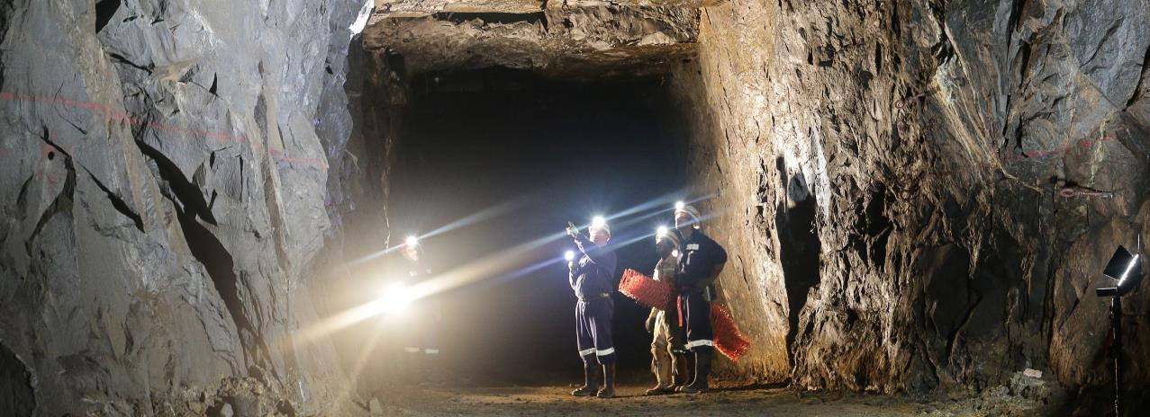
Prieska: NEXT STEPS
FOUNDATION PHASE
Orion progressing key commercial work streams:
  Permitting
  Concentrate marketing
  Project financing
Final investment decision targeted in H2 2019
Commencement of construction targeted for late 2019/early 2020
Ongoing optimisation studies
Evaluating by-product production and sales
  Barite
  Pyrite
LOM EXTENSION PHASE
Resource extension drilling to commence following establishment of underground drilling platforms
– targeting strike extensions and folded limb of the main Prieska VMS lens, which remains open
Exploration for near mine satellite bodies to continue from surface

Slide 23
Construction Milestones
Milestone Description Month |  | 1 |  |  |  |  |  |  |  |  | 10 |  |  |  |  |  |  |  |  |  | 20 |  |  |  |  |  |  |  |  |  | 30 |  |  | 33
E V A P O R A T I O N D A M & T S F
EIA Amendment Process
Construct, Line & Commission Evaporation Dams
Construct and Commission TSF
S H A F T D E W A T E R I N G & C O N S T R U C T I O N
Surface & Shaft Preparation, Pump Installation 294 Level
De-water & Slurry Pumping to 1,025 Level
957 Level Mining Construction Works
Permanent Headgear Completion & Winder Commissioning
M I N I N G P R O C U R E M E N T A C T I V I T I E S
UG Development & Production Upper NW Section
UG Development & Production 957 Level NW
UG Development & Production 957 Level SE
P R O C E S S & P A S T E F I L L P L A N T
Process Plant and Paste Plant Construction & Commissioning
I N F R A S T R U C T U R E, E A R T H W O R K S, C I V I L
Build 572 Man Construction Camp
I N F R A S T R U C T U R E, C I V I L & E A R T H W O R K S
Earthworks
Infrastructure & Civil Construction; Structural & Platework Installation; Electrical & Instrumentation
Bulk Water Supply Works
Install and Commission Main Consumer Sub-Station; Temporary Eskom Power
Refer ASX release 26 June 2019

Slide 24
Mining production profile
Underground mining for majority of the Foundation Phase
Small open pit mined on retreat
Underground mining to commence on completion of:
  mine dewatering
  shaft refurbishment
Underground establishment program of 23 months before first ore mined
Underground mining will build up over 14 months to steady-state run-of-mine production rate of 200ktpm or 2.4Mtpa
MILLED ORE SOURCES
MILLED ORE JORC CATEGORIES
Refer ASX release 26 June 2019

Slide 25
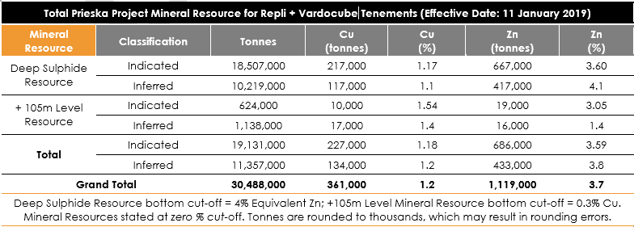
Mineral Resource
The Mineral Resources are inclusive of the Mineral Reserves
Refer ASX release 26 June 2019

Slide 26
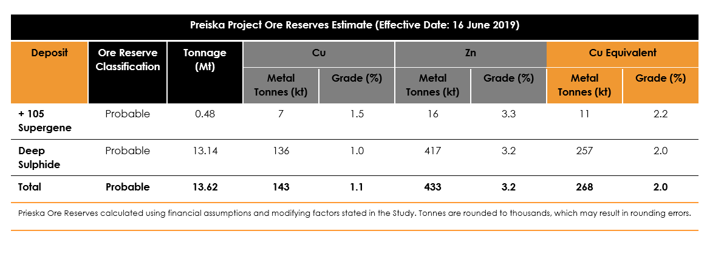
Mineral Reserve
Refer ASX release 26 June 2019

Slide 27
Mine face to market
Refer ASX release 26 June 2019

Slide 28
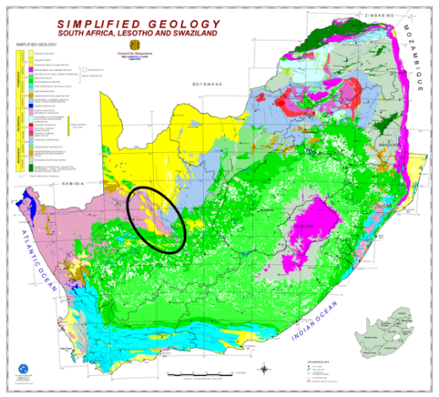
A DOMINANT LAND-HOLDING IN
AN UNDER-EXPLORED mineral BELT
Highly prospective yet under-explored mineral province
22 identified VMS occurrences historically confirmed by major
mining houses
Reputed to have the highest concentration of zinc on the African
continent¹:
  Large-scale sediment-hosted deposits classified
  as Broken Hill, SEDEX and VMS
  >40Mt of contained zinc
Several known intrusive Ni-Cu-PGE occurrences with limited
modern exploration
Potential for discovery of high-grade Ni-Cu deposits
1 Source: Vedanta Capital Markets Day presentation, March 2015

Slide 29
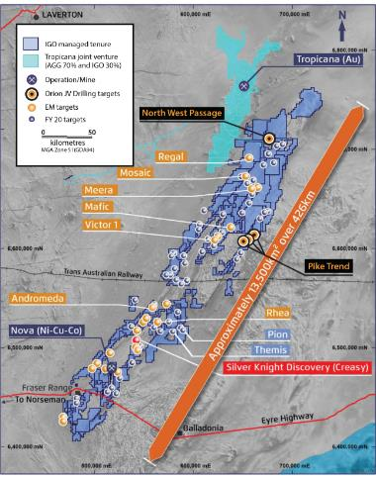
FRAser range: searching for a supernova
“We have a conviction the (Nova) system is much larger than we believed, and the increased probability of additional discoveries means we are motivated to significantly increase our spending in 2020.” – IGO Managing Director Peter Bradford, quoted on Miningnews.net, 31 July 2019
IGO has commenced drilling on the North West Passage Ni-Cu JV geophysical prospect
Drilling will also test combined Ni-Cu Intrusive and Cu-Zn VMS targets identified at the Pike, Pike-Eye and Hook Prospects
Drilling forms part of a larger exploration program across the northern part of the Fraser Range and it is expected that, following completion of drilling at the North West Passage, drilling will move to the highly prospective Pike Trend (IGO 70% : Orion 30%) during the latter part of 2019
Source: IGO

Slide 30
CORPORATE STRUCTURE
Capital structure summary | Current | Post Capital Raising
Shares on issue¹ | 2,111M | 2,111M
Options on issue² | 288M | 315M
Cash on hand³ | $1.4M
Placement of Shares – (Tranche 2)² - ($2.1M) |  | 54M
Founding BEE investor share exchange⁴ - ($4.2M) |  | 135M
AASMF loan⁵ | $1.8M
Convertible notes (2.6cps convert, 12% coupon, Sep‘19 maturity) ⁶ | $5.8M
Convertible loan (2.6cps convert, 12% interest, Jan‘20 term) ⁷ | $4.0M
Total Shares (post Share issues) |  | 2,300M
Market capitalisation (2.6cps (ASX))⁸ | $55M | $60M
Primary listing on the ASX.
Secondary listing on Main Board of the Johannesburg Stock Exchange.
Significant shareholders | Current % | Post capital raising %
Tembo Capital | 22.8 | 20.9
Independence Group NL | 7.3 | 6.7
Tarney Holdings | 5.3 | 4.9
Wyllie Group | 5.2 | 4.8
Silja Investment & Alexander Haller⁹ | 3.3 | 3.0
Total | 43.9 | 40.3
Fully paid ordinary Orion shares (Shares) on issue as at 2 Aug’19.
Completion of Tranche 2 of the $8M capital raising, being the issue of 53.71M Shares at 4.0cps (together with one free attaching option for every two Shares issued) (approved by shareholders at a General Meeting held 7 Jun’19 (Meeting)) (refer ASX release 16 Apr’19).
Cash on hand as at 30 Jun ‘19.
Founding BEE investor exchange for Shares (approved by shareholders at the Meeting) (refer ASX release 16 Apr’19).
Refer to the Company’s Half Year Accounts for period ended 31 Dec’18 for information related to the Loan Agreement (ZAR14.25M) that Repli has entered into with AASMF. Balance shown as at 30 Jun’19.
Refer to ASX release 25 Jan’19 and the Company’s Half Year Accounts for period ended 31 Dec’18 for information related to the Convertible Notes.
Orion announced on 25 Jan’19 that it had entered into a $3.6M loan facility with Tembo Capital (excluding capitalised interest and fees) (Loan Facility). Under the terms of the Loan Facility, Tembo may at its election have the balance of the Loan Facility settled by the issue of Shares at a deemed issue price of 2.6cps (subject to receipt of shareholder approval). Refer to ASX release 25 Jan’19 and the Company’s Half Year Accounts for the period ended 31 Dec’18 for additional information. Balance shown as at 30 Jun’19.
Calculated based on closing price of ORN Shares on the ASX on 2 Aug‘19. Closing price of ORN Shares on the JSE on 2 Aug‘19 was ZAR0.30.
Alexander Haller is deemed to have a relevant interest in securities held by Silja Investment.

Slide 31
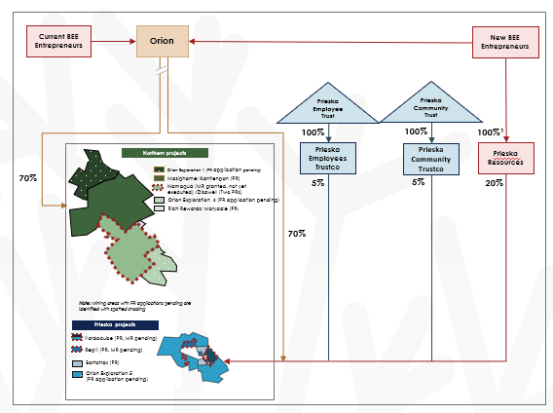
Pivotal $8M capital raising and BEE transaction
Safika Resources
Black Star Minerals
Kolobe Nala Investment
44.72%
17.31%
39.97%
Prieska Resources
20%
Refer ASX release 2 August 2019

Slide 32
For further information, contact:
Orion Minerals Limited
Phone: +61 (0)3 8080 7170
Email: info@orionminerals.com.au
Website: www.orionminerals.com.au

